Slide 1
SOA Exam FM
Module 3 – Section 7
Callable Bond Examples

Slide 2
Example 1
A 1000 face value 20-year callable bond with 3% annual coupons can be redeemed according to the following schedule:
1000 at the end of years 10 through 14
1075 at the end of years 15 through 17
1125 at the end of years 18 through 20
Determine the maximum price a buyer should pay in order to earn an annual yield of at least 5%.

Slide 3
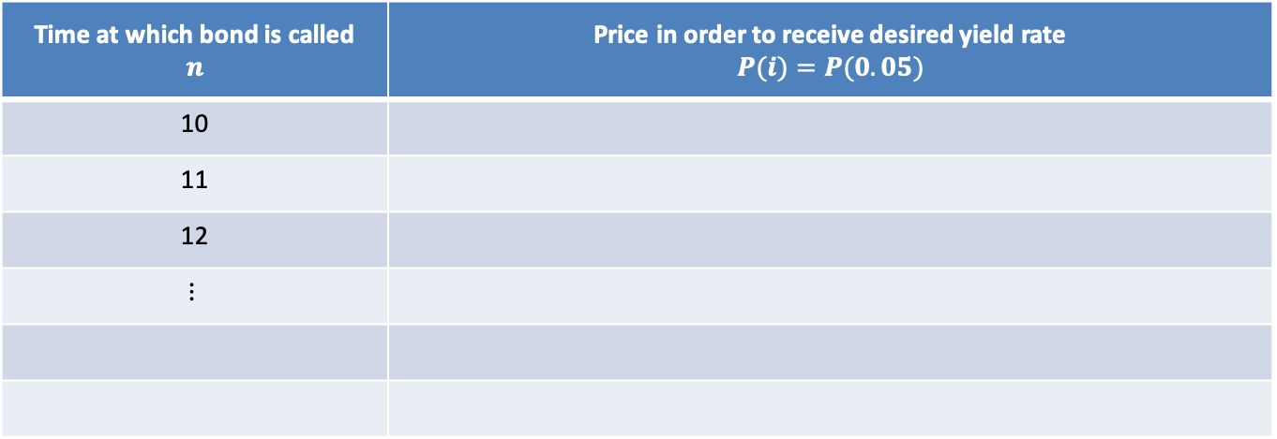
Example 1
A 1000 face value 20-year callable bond with 3% annual coupons can be redeemed according to the following schedule:
1000 at the end of years 10 through 14
1075 at the end of years 15 through 17
1125 at the end of years 18 through 20
Determine the maximum price a buyer should pay in order to earn an annual yield of at least 5%.
Time at which bond is called $$n$$ | Price in order to receive desired yield rate $$P(i)=P(0.05)$$
10
11
12
$$⋮$$

Slide 4
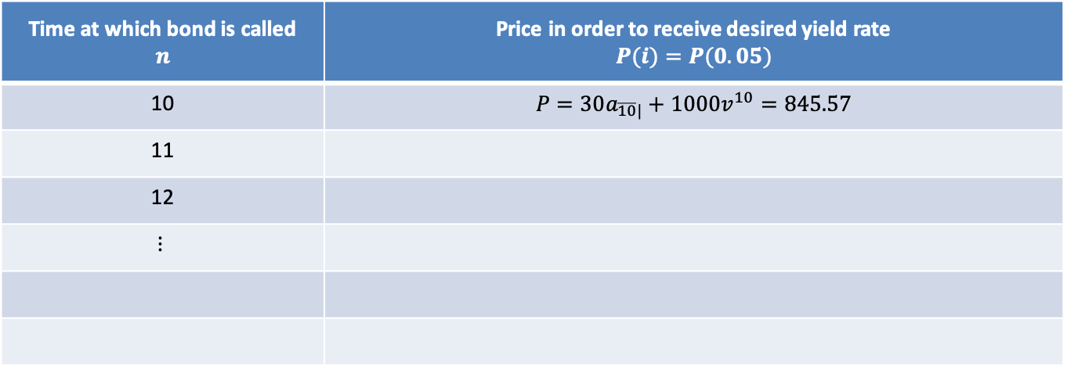
Example 1
A 1000 face value 20-year callable bond with 3% annual coupons can be redeemed according to the following schedule:
1000 at the end of years 10 through 14
1075 at the end of years 15 through 17
1125 at the end of years 18 through 20
Determine the maximum price a buyer should pay in order to earn an annual yield of at least 5%.
Time at which bond is called $$n$$ | Price in order to receive desired yield rate $$P(i)=P(0.05)$$
10 | $$P=30a_{\overline{10}|}+1000v^{10}=845.57$$
11
12
$$⋮$$

Slide 5
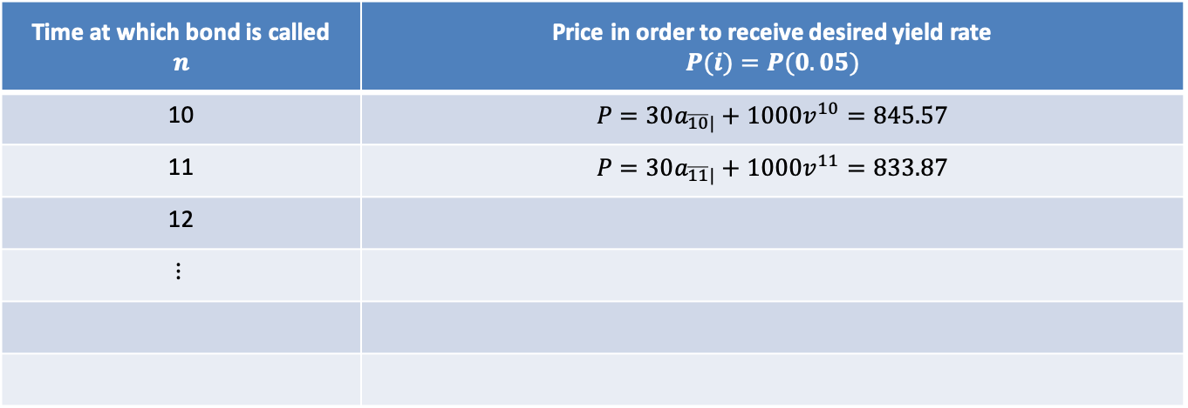
Example 1
A 1000 face value 20-year callable bond with 3% annual coupons can be redeemed according to the following schedule:
1000 at the end of years 10 through 14
1075 at the end of years 15 through 17
1125 at the end of years 18 through 20
Determine the maximum price a buyer should pay in order to earn an annual yield of at least 5%.
Time at which bond is called $$n$$ | Price in order to receive desired yield rate $$P(i)=P(0.05)$$
10 | $$P=30a_{\overline{10}|}+1000v^{10}=845.57$$
11 | $$P=30a_{\overline{11}|}+1000v^{11}=833.87$$
12
$$⋮$$

Slide 6
Example 1
A 1000 face value 20-year callable bond with 3% annual coupons can be redeemed according to the following schedule:
1000 at the end of years 10 through 14
1075 at the end of years 15 through 17
1125 at the end of years 18 through 20
Determine the maximum price a buyer should pay in order to earn an annual yield of at least 5%.
NOTE: The prices will systematically increase or decrease (decrease in this problem) when the redemption value remains the same.
Time at which bond is called $$n$$ | Price in order to receive desired yield rate $$P(i)=P(0.05)$$
10 | $$P=30a_{\overline{10}|}+1000v^{10}=845.57$$
11 | $$P=30a_{\overline{11}|}+1000v^{11}=833.87$$
12
$$⋮$$

Slide 7
Example 1
A 1000 face value 20-year callable bond with 3% annual coupons can be redeemed according to the following schedule:
1000 at the end of years 10 through 14
1075 at the end of years 15 through 17
1125 at the end of years 18 through 20
Determine the maximum price a buyer should pay in order to earn an annual yield of at least 5%.
NOTE: The prices will systematically increase or decrease (decrease in this problem) when the redemption value remains the same. Therefore, we only need to check endpoints for the same redemption values.
Time at which bond is called $$n$$ | Price in order to receive desired yield rate $$P(i)=P(0.05)$$
10 | $$P=30a_{\overline{10}|}+1000v^{10}=845.57$$
11 | $$P=30a_{\overline{11}|}+1000v^{11}=833.87$$
12
$$⋮$$

Slide 8
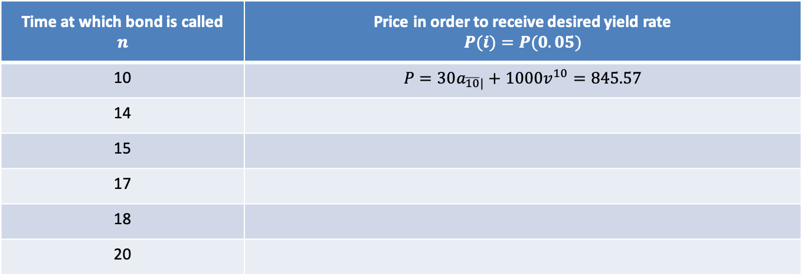
Example 1
A 1000 face value 20-year callable bond with 3% annual coupons can be redeemed according to the following schedule:
1000 at the end of years 10 through 14
1075 at the end of years 15 through 17
1125 at the end of years 18 through 20
Determine the maximum price a buyer should pay in order to earn an annual yield of at least 5%.
Time at which bond is called $$n$$ | Price in order to receive desired yield rate $$P(i)=P(0.05)$$
10 | $$P=30a_{\overline{10}|}+1000v^{10}=845.57$$
14
15
17
18
20

Slide 9
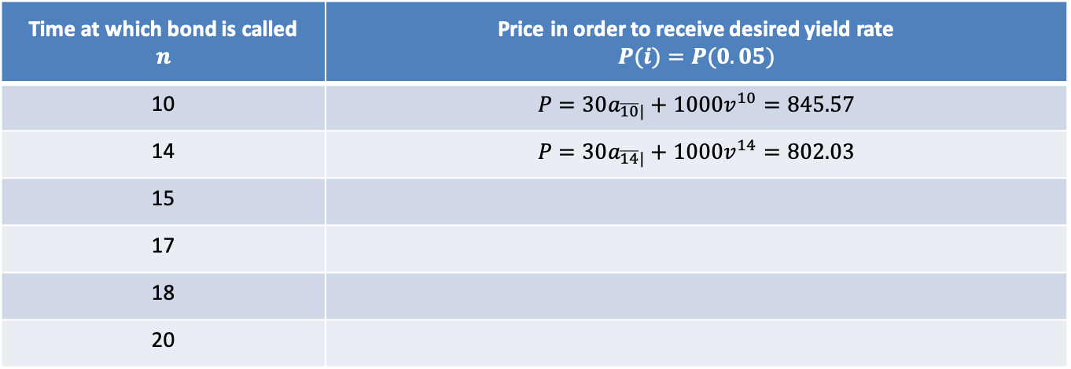
Example 1
A 1000 face value 20-year callable bond with 3% annual coupons can be redeemed according to the following schedule:
1000 at the end of years 10 through 14
1075 at the end of years 15 through 17
1125 at the end of years 18 through 20
Determine the maximum price a buyer should pay in order to earn an annual yield of at least 5%.
Time at which bond is called $$n$$ | Price in order to receive desired yield rate $$P(i)=P(0.05)$$
10 | $$P=30a_{\overline{10}|}+1000v^{10}=845.57$$
14 | $$P=30a_{\overline{14}|}+1000v^{14}=802.03$$
15
17
18
20

Slide 10
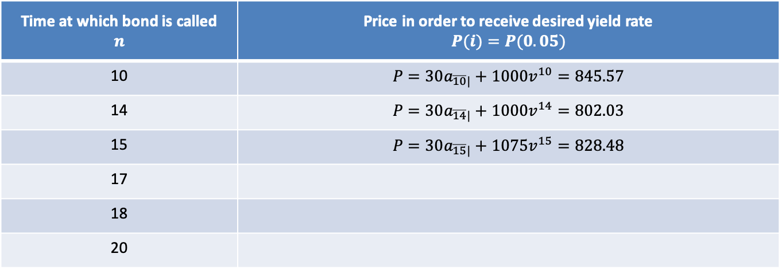
Example 1
A 1000 face value 20-year callable bond with 3% annual coupons can be redeemed according to the following schedule:
1000 at the end of years 10 through 14
1075 at the end of years 15 through 17
1125 at the end of years 18 through 20
Determine the maximum price a buyer should pay in order to earn an annual yield of at least 5%.
Time at which bond is called $$n$$ | Price in order to receive desired yield rate $$P(i)=P(0.05)$$
10 | $$P=30a_{\overline{10}|}+1000v^{10}=845.57$$
14 | $$P=30a_{\overline{14}|}+1000v^{14}=802.03$$
15 | $$P=30a_{\overline{15}|}+1075v^{15}=828.48$$
17
18
20

Slide 11
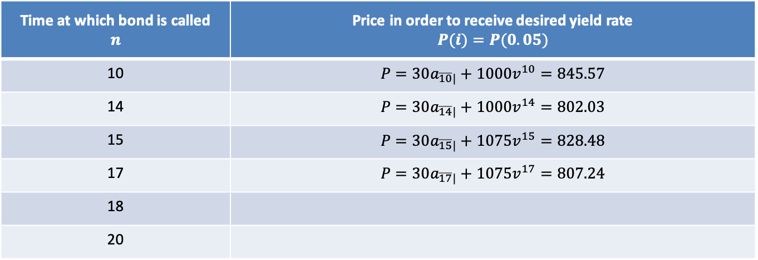
Example 1
A 1000 face value 20-year callable bond with 3% annual coupons can be redeemed according to the following schedule:
1000 at the end of years 10 through 14
1075 at the end of years 15 through 17
1125 at the end of years 18 through 20
Determine the maximum price a buyer should pay in order to earn an annual yield of at least 5%.
Time at which bond is called $$n$$ | Price in order to receive desired yield rate $$P(i)=P(0.05)$$
10 | $$P=30a_{\overline{10}|}+1000v^{10}=845.57$$
14 | $$P=30a_{\overline{14}|}+1000v^{14}=802.03$$
15 | $$P=30a_{\overline{15}|}+1075v^{15}=828.48$$
17 | $$P=30a_{\overline{17}|}+1075v^{17}=807.24$$
18
20

Slide 12
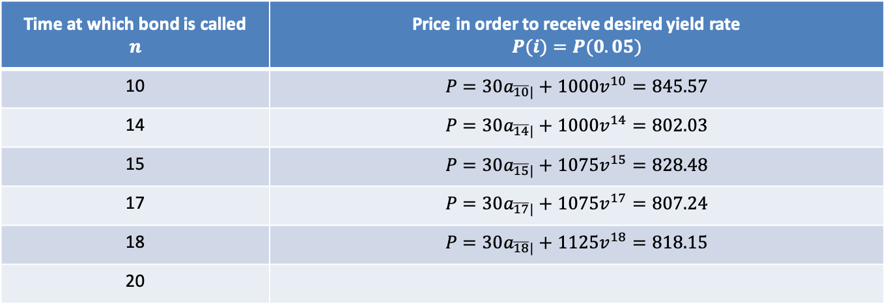
Example 1
A 1000 face value 20-year callable bond with 3% annual coupons can be redeemed according to the following schedule:
1000 at the end of years 10 through 14
1075 at the end of years 15 through 17
1125 at the end of years 18 through 20
Determine the maximum price a buyer should pay in order to earn an annual yield of at least 5%.
Time at which bond is called $$n$$ | Price in order to receive desired yield rate $$P(i)=P(0.05)$$
10 | $$P=30a_{\overline{10}|}+1000v^{10}=845.57$$
14 | $$P=30a_{\overline{14}|}+1000v^{14}=802.03$$
15 | $$P=30a_{\overline{15}|}+1075v^{15}=828.48$$
17 | $$P=30a_{\overline{17}|}+1075v^{17}=807.24$$
18 | $$P=30a_{\overline{18}|}+1125v^{18}=818.15$$
20

Slide 13
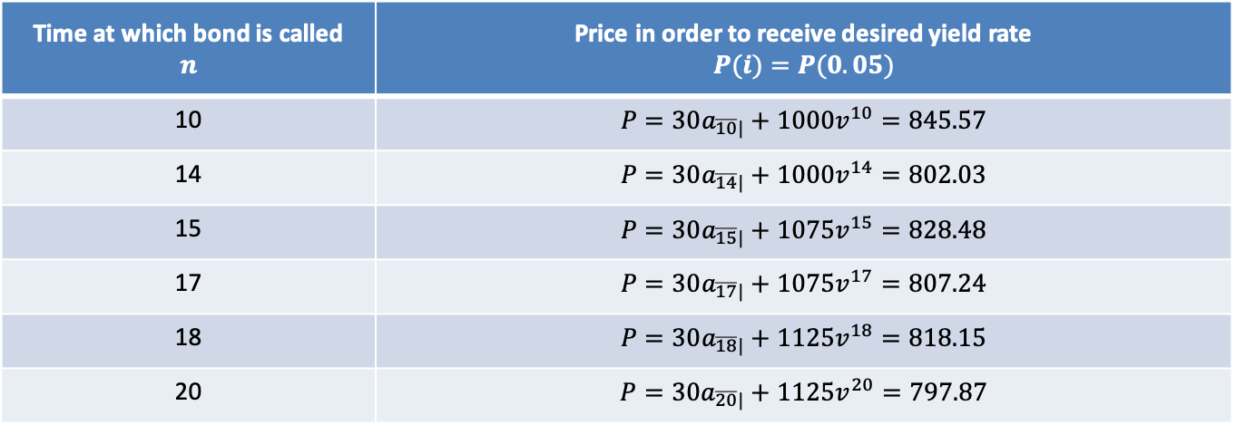
Example 1
A 1000 face value 20-year callable bond with 3% annual coupons can be redeemed according to the following schedule:
1000 at the end of years 10 through 14
1075 at the end of years 15 through 17
1125 at the end of years 18 through 20
Determine the maximum price a buyer should pay in order to earn an annual yield of at least 5%.
Time at which bond is called $$n$$ | Price in order to receive desired yield rate $$P(i)=P(0.05)$$
10 | $$P=30a_{\overline{10}|}+1000v^{10}=845.57$$
14 | $$P=30a_{\overline{14}|}+1000v^{14}=802.03$$
15 | $$P=30a_{\overline{15}|}+1075v^{15}=828.48$$
17 | $$P=30a_{\overline{17}|}+1075v^{17}=807.24$$
18 | $$P=30a_{\overline{18}|}+1125v^{18}=818.15$$
20 | $$P=30a_{\overline{20}|}+1125v^{20}=797.87$$

Slide 14
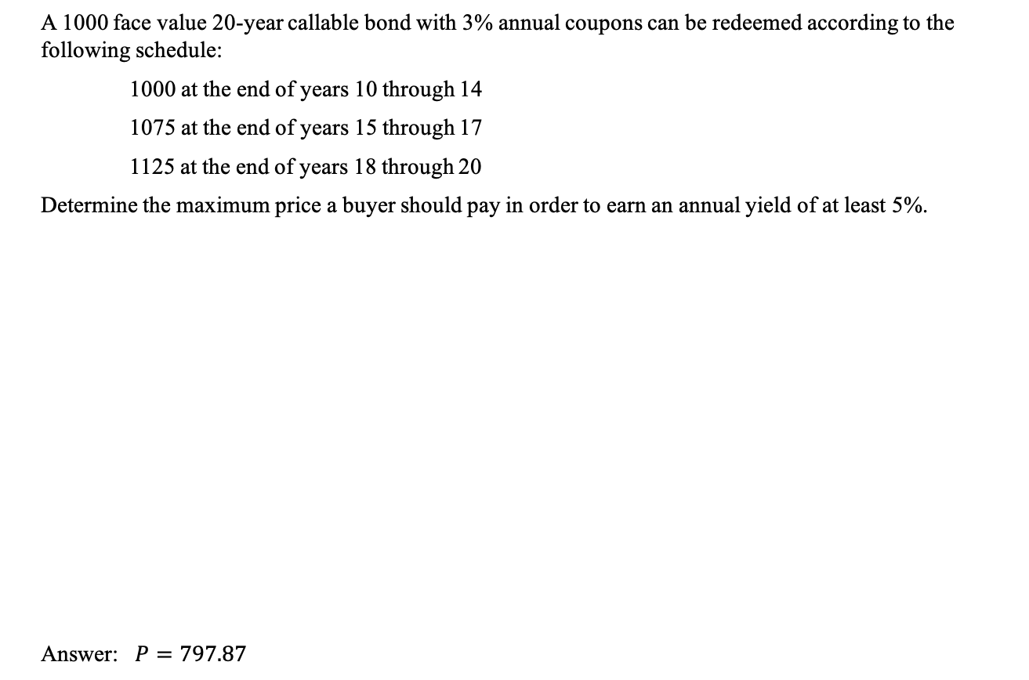
Example 1
A 1000 face value 20-year callable bond with 3% annual coupons can be redeemed according to the following schedule:
1000 at the end of years 10 through 14
1075 at the end of years 15 through 17
1125 at the end of years 18 through 20
Determine the maximum price a buyer should pay in order to earn an annual yield of at least 5%.
Answer: $P=797.87$
Time at which bond is called $$n$$ | Price in order to receive desired yield rate $$P(i)=P(0.05)$$
10 | $$P=30a_{\overline{10}|}+1000v^{10}=845.57$$
14 | $$P=30a_{\overline{14}|}+1000v^{14}=802.03$$
15 | $$P=30a_{\overline{15}|}+1075v^{15}=828.48$$
17 | $$P=30a_{\overline{17}|}+1075v^{17}=807.24$$
18 | $$P=30a_{\overline{18}|}+1125v^{18}=818.15$$
20 | $$P=30a_{\overline{20}|}+1125v^{20}=797.87$$

Slide 15
Example 1
A 1000 face value 20-year callable bond with 3% annual coupons can be redeemed according to the following schedule:
1000 at the end of years 10 through 14
1075 at the end of years 15 through 17
1125 at the end of years 18 through 20
Determine the maximum price a buyer should pay in order to earn an annual yield of at least 5%. You buy the bond for 797.87. Determine the yield if the bond is redeemed at the end of year 16.

Slide 16

Example 1
A 1000 face value 20-year callable bond with 3% annual coupons can be redeemed according to the following schedule:
1000 at the end of years 10 through 14
1075 at the end of years 15 through 17
1125 at the end of years 18 through 20
Determine the maximum price a buyer should pay in order to earn an annual yield of at least 5%. You buy the bond for 797.87. Determine the yield if the bond is redeemed at the end of year 16.
$$797.87=30a_{\overline{16}|}+1075v^{16}$$

Slide 17
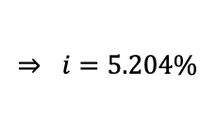
Example 1
A 1000 face value 20-year callable bond with 3% annual coupons can be redeemed according to the following schedule:
1000 at the end of years 10 through 14
1075 at the end of years 15 through 17
1125 at the end of years 18 through 20
Determine the maximum price a buyer should pay in order to earn an annual yield of at least 5%. You buy the bond for 797.87. Determine the yield if the bond is redeemed at the end of year 16.
$$797.87=30a_{\overline{16}|}+1075v^{16}$$
$$⇒ i=5.204\%$$

Slide 18
Example 2
A 1000 face value 10-year callable bond with 8% semiannual coupons is bought for 1050. The bond can be redeemed at the end of any year starting with year 7. Determine the minimum annual yield for this bond.

Slide 19
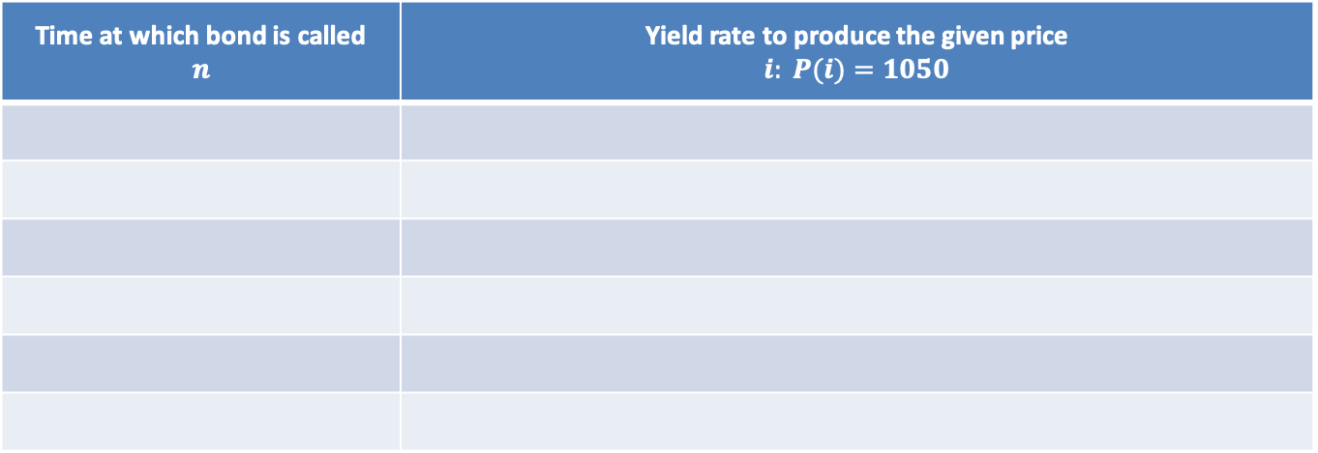
Example 2
A 1000 face value 10-year callable bond with 8% semiannual coupons is bought for 1050. The bond can be redeemed at the end of any year starting with year 7. Determine the minimum annual yield for this bond.
Time at which bond is called $$n$$ | Yield rate to produce the given price $$i: P(i)=1050$$

Slide 20
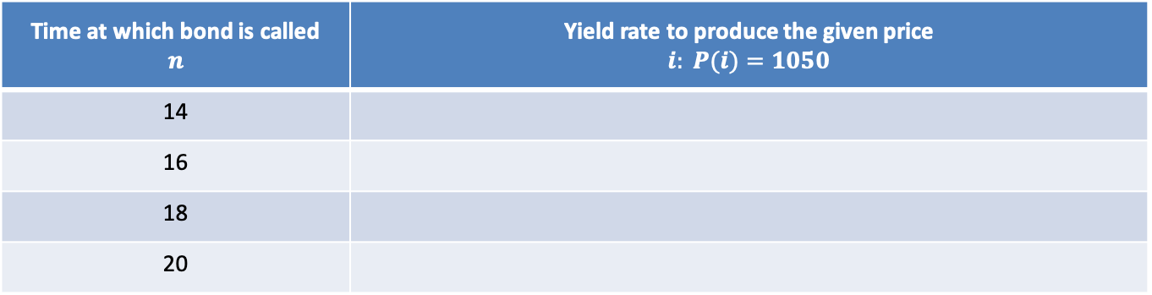
Example 2
A 1000 face value 10-year callable bond with 8% semiannual coupons is bought for 1050. The bond can be redeemed at the end of any year starting with year 7. Determine the minimum annual yield for this bond.
Time at which bond is called $$n$$ | Yield rate to produce the given price $$i: P(i)=1050$$
14
16
18
20

Slide 21
Example 2
A 1000 face value 10-year callable bond with 8% semiannual coupons is bought for 1050. The bond can be redeemed at the end of any year starting with year 7. Determine the minimum annual yield for this bond.
There is no redemption value stated or implied.
Time at which bond is called $$n$$ | Yield rate to produce the given price $$i: P(i)=1050$$
14
16
18
20

Slide 22
Example 2
A 1000 face value 10-year callable bond with 8% semiannual coupons is bought for 1050. The bond can be redeemed at the end of any year starting with year 7. Determine the minimum annual yield for this bond.
There is no redemption value stated or implied. For all bond problems, when this is the case, assume the bond is redeemable at par.
Time at which bond is called $$n$$ | Yield rate to produce the given price $$i: P(i)=1050$$
14
16
18
20

Slide 23
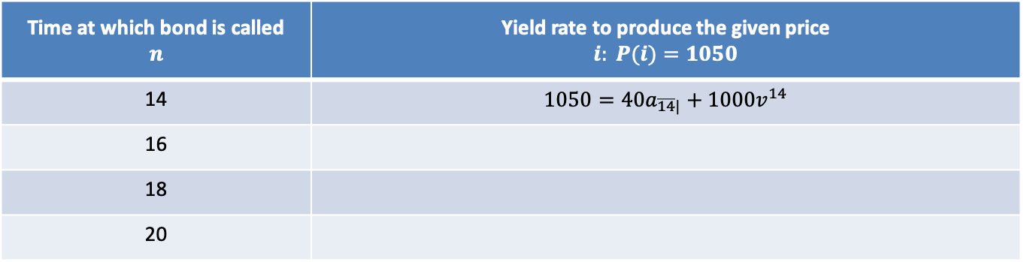
Example 2
A 1000 face value 10-year callable bond with 8% semiannual coupons is bought for 1050. The bond can be redeemed at the end of any year starting with year 7. Determine the minimum annual yield for this bond.
There is no redemption value stated or implied. For all bond problems, when this is the case, assume the bond is redeemable at par.
Time at which bond is called $$n$$ | Yield rate to produce the given price $$i: P(i)=1050$$
14 | $$1050=40a_{\overline{14}|}+1000v^{14}$$
16
18
20

Slide 24
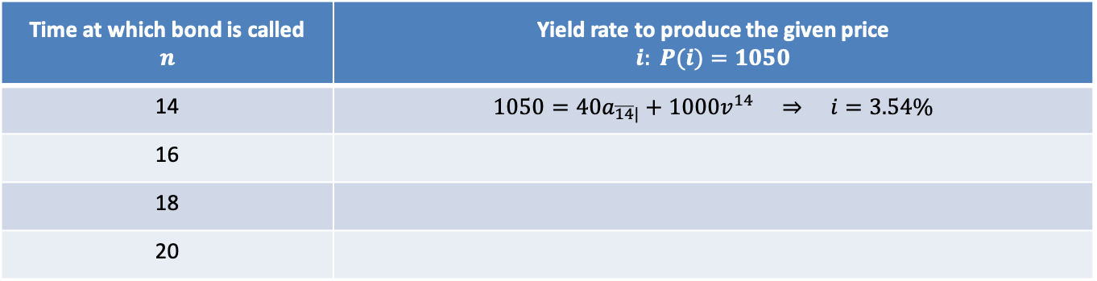
Example 2
A 1000 face value 10-year callable bond with 8% semiannual coupons is bought for 1050. The bond can be redeemed at the end of any year starting with year 7. Determine the minimum annual yield for this bond.
There is no redemption value stated or implied. For all bond problems, when this is the case, assume the bond is redeemable at par.
Time at which bond is called $$n$$ | Yield rate to produce the given price $$i: P(i)=1050$$
14 | $$1050=40a_{\overline{14}|}+1000v^{14} ⇒ i=3.54\%$$
16
18
20

Slide 25
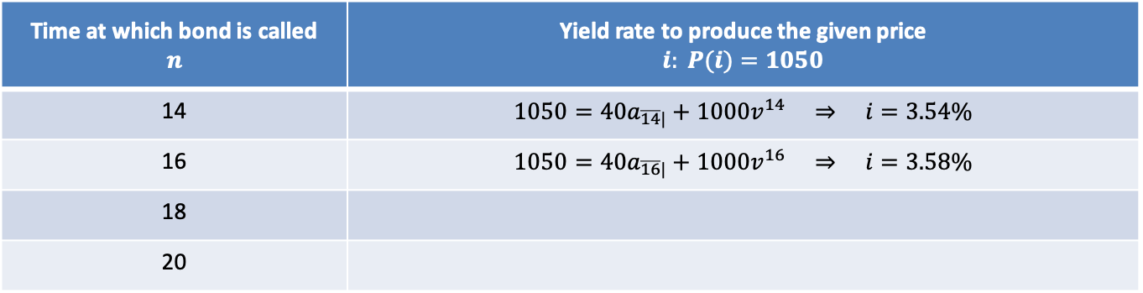
Example 2
A 1000 face value 10-year callable bond with 8% semiannual coupons is bought for 1050. The bond can be redeemed at the end of any year starting with year 7. Determine the minimum annual yield for this bond.
There is no redemption value stated or implied. For all bond problems, when this is the case, assume the bond is redeemable at par.
Time at which bond is called $$n$$ | Yield rate to produce the given price $$i: P(i)=1050$$
14 | $$1050=40a_{\overline{14}|}+1000v^{14} ⇒ i=3.54\%$$
16 | $$1050=40a_{\overline{16}|}+1000v^{16} ⇒ i=3.58\%$$
18
20

Slide 26
Example 2
A 1000 face value 10-year callable bond with 8% semiannual coupons is bought for 1050. The bond can be redeemed at the end of any year starting with year 7. Determine the minimum annual yield for this bond.
There is no redemption value stated or implied. For all bond problems, when this is the case, assume the bond is redeemable at par.
NOTE: The interest rates will systematically increase or decrease (increase in this problem) when the redemption value remains the same.
Time at which bond is called $$n$$ | Yield rate to produce the given price $$i: P(i)=1050$$
14 | $$1050=40a_{\overline{14}|}+1000v^{14} ⇒ i=3.54\%$$
16 | $$1050=40a_{\overline{16}|}+1000v^{16} ⇒ i=3.58\%$$
18
20

Slide 27
Example 2
A 1000 face value 10-year callable bond with 8% semiannual coupons is bought for 1050. The bond can be redeemed at the end of any year starting with year 7. Determine the minimum annual yield for this bond.
There is no redemption value stated or implied. For all bond problems, when this is the case, assume the bond is redeemable at par.
NOTE: The interest rates will systematically increase or decrease (increase in this problem) when the redemption value remains the same. Therefore, we only need to check endpoints for the same redemption values.
Time at which bond is called $$n$$ | Yield rate to produce the given price $$i: P(i)=1050$$
14 | $$1050=40a_{\overline{14}|}+1000v^{14} ⇒ i=3.54\%$$
16 | $$1050=40a_{\overline{16}|}+1000v^{16} ⇒ i=3.58\%$$
18
20

Slide 28
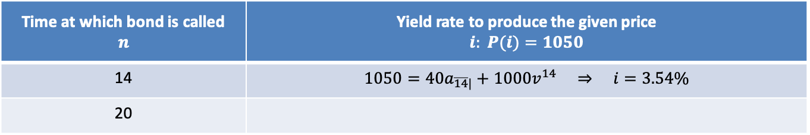
Example 2
A 1000 face value 10-year callable bond with 8% semiannual coupons is bought for 1050. The bond can be redeemed at the end of any year starting with year 7. Determine the minimum annual yield for this bond.
Time at which bond is called $$n$$ | Yield rate to produce the given price $$i: P(i)=1050$$
14 | $$1050=40a_{\overline{14}|}+1000v^{14} ⇒ i=3.54\%$$
20

Slide 29
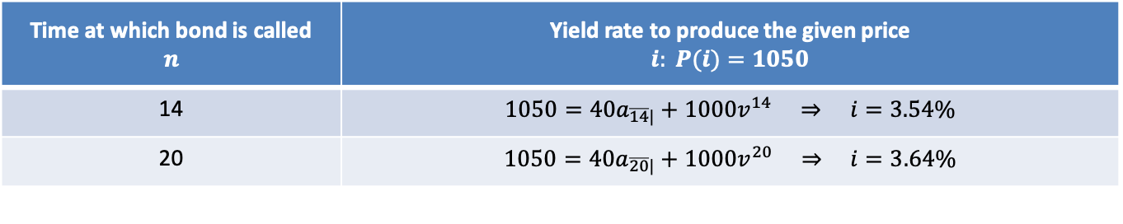
Example 2
A 1000 face value 10-year callable bond with 8% semiannual coupons is bought for 1050. The bond can be redeemed at the end of any year starting with year 7. Determine the minimum annual yield for this bond.
Time at which bond is called $$n$$ | Yield rate to produce the given price $$i: P(i)=1050$$
14 | $$1050=40a_{\overline{14}|}+1000v^{14} ⇒ i=3.54\%$$
20 | $$1050=40a_{\overline{20}|}+1000v^{20} ⇒ i=3.64\%$$

Slide 30

Example 2
A 1000 face value 10-year callable bond with 8% semiannual coupons is bought for 1050. The bond can be redeemed at the end of any year starting with year 7. Determine the minimum annual yield for this bond.
Answer: $i=3.54\%$
Time at which bond is called $$n$$ | Yield rate to produce the given price $$i: P(i)=1050$$
14 | $$1050=40a_{\overline{14}|}+1000v^{14} ⇒ i=3.54\%$$
20 | $$1050=40a_{\overline{20}|}+1000v^{20} ⇒ i=3.64\%$$

Slide 31

Example 2
A 1000 face value 10-year callable bond with 8% semiannual coupons is bought for 1050. The bond can be redeemed at the end of any year starting with year 7. Determine the minimum annual yield for this bond.
Answer: $i=3.54\% (seir)$
Time at which bond is called $$n$$ | Yield rate to produce the given price $$i: P(i)=1050$$
14 | $$1050=40a_{\overline{14}|}+1000v^{14} ⇒ i=3.54\%$$
20 | $$1050=40a_{\overline{20}|}+1000v^{20} ⇒ i=3.64\%$$

Slide 32

Example 2
A 1000 face value 10-year callable bond with 8% semiannual coupons is bought for 1050. The bond can be redeemed at the end of any year starting with year 7. Determine the minimum annual yield for this bond.
Answer: $i=3.54\% \left(seir\right) ⇒ aeir={1.0354}^{2}−1=7.21\%$
Time at which bond is called $$n$$ | Yield rate to produce the given price $$i: P(i)=1050$$
14 | $$1050=40a_{\overline{14}|}+1000v^{14} ⇒ i=3.54\%$$
20 | $$1050=40a_{\overline{20}|}+1000v^{20} ⇒ i=3.64\%$$

Slide 33

Example 2
A 1000 face value 10-year callable bond with 8% semiannual coupons is bought for 1050. The bond can be redeemed at the end of any year starting with year 7. Determine the minimum annual yield for this bond.
Answer: $i=3.54\% \left(seir\right) ⇒ aeir={1.0354}^{2}−1=7.21\%$
Time at which bond is called $$n$$ | Yield rate to produce the given price $$i: P(i)=1050$$
14 | $$1050=40a_{\overline{14}|}+1000v^{14} ⇒ i=3.54\%$$
20 | $$1050=40a_{\overline{20}|}+1000v^{20} ⇒ i=3.64\%$$

