Slide 1
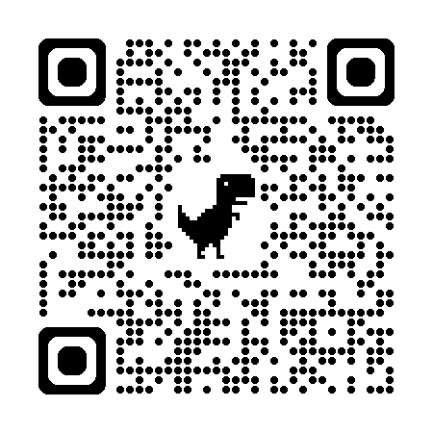
Accessibility by Design
A 3-Pilllar Framework for Student Success
Workshop Companion page:
https://math.fsu.edu/~kolarkar/resources/workshop-cotl26.html
Ameya S. Kolarkar, Ph.D.
Florida State University
Featured Workshop at the CoTL 2026 Conference
May 12, 2026
Or
scan the QR code above.
This webpage provides AI prompts and additional digital resources.

Slide 2
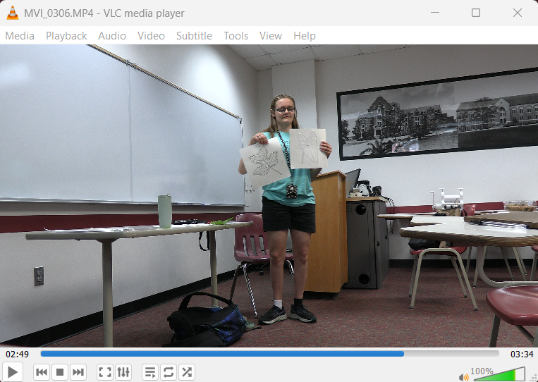
Some background
Students with “disabilities” report “terrible” learning experiences.
Many change majors
Let’s Talk!
They deserve the same learning and college experiences as everyone else!
But wait!
What do we even mean by “disability”?

Slide 3
The Issue
Students with disabilities are just as smart and capable of learning as their able counterparts.
They simply need ...
access in different formats
different ways to show their thinking and understanding.
UDL!

Slide 4
Consider these “Goals” examples
After completing this course/topic, students will be able to ...
sight-read and play simple musical passages.
rapidly compute solutions to derivatives under strict time constraints.
demonstrate their understanding of historical eras by delivering a live oral presentation to the class.

Slide 5
Activity 1 (Individual or Group)
In your handout, find Activity 1.
Individually think, or in a small group discuss, about any "accessibility issues" you see in these examples.
Write out these issues in the space provided.
After thinking or discussing, write out what you think could be better versions.
Examples from previous slide…
After completing this course/topic, students will be able to ...
sight-read and play simple musical passages.
rapidly compute solutions to derivatives under strict time constraints.
demonstrate their understanding of historical eras by delivering a live oral presentation to the class.

Slide 6
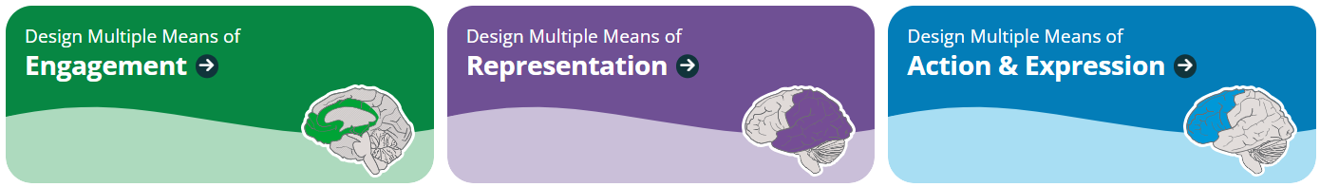
Backward Design and UDL
Backward Design Summary
Stage 1: Identify Desired Results
Stage 2: Determine Acceptable Evidence
Stage 3: Plan Learning Experiences

Slide 7
The Remediation Trap
The "Checklist" Approach
Treating accessibility as a post-production task
Trying to "fix" messy content instead of designing for clarity from the start.
Impact on Morale
Accessibility feels like a (legal) burden rather than an act of hospitality
Engagement drops for both faculty and students.

Slide 8
Some ‘Material’ Examples
Unstructured PDFs and blurry scans.
Lack of semantic headings for navigation.
Inaccessible equations in foundational math.
Accessibility is more than just (online) materials!

Slide 9
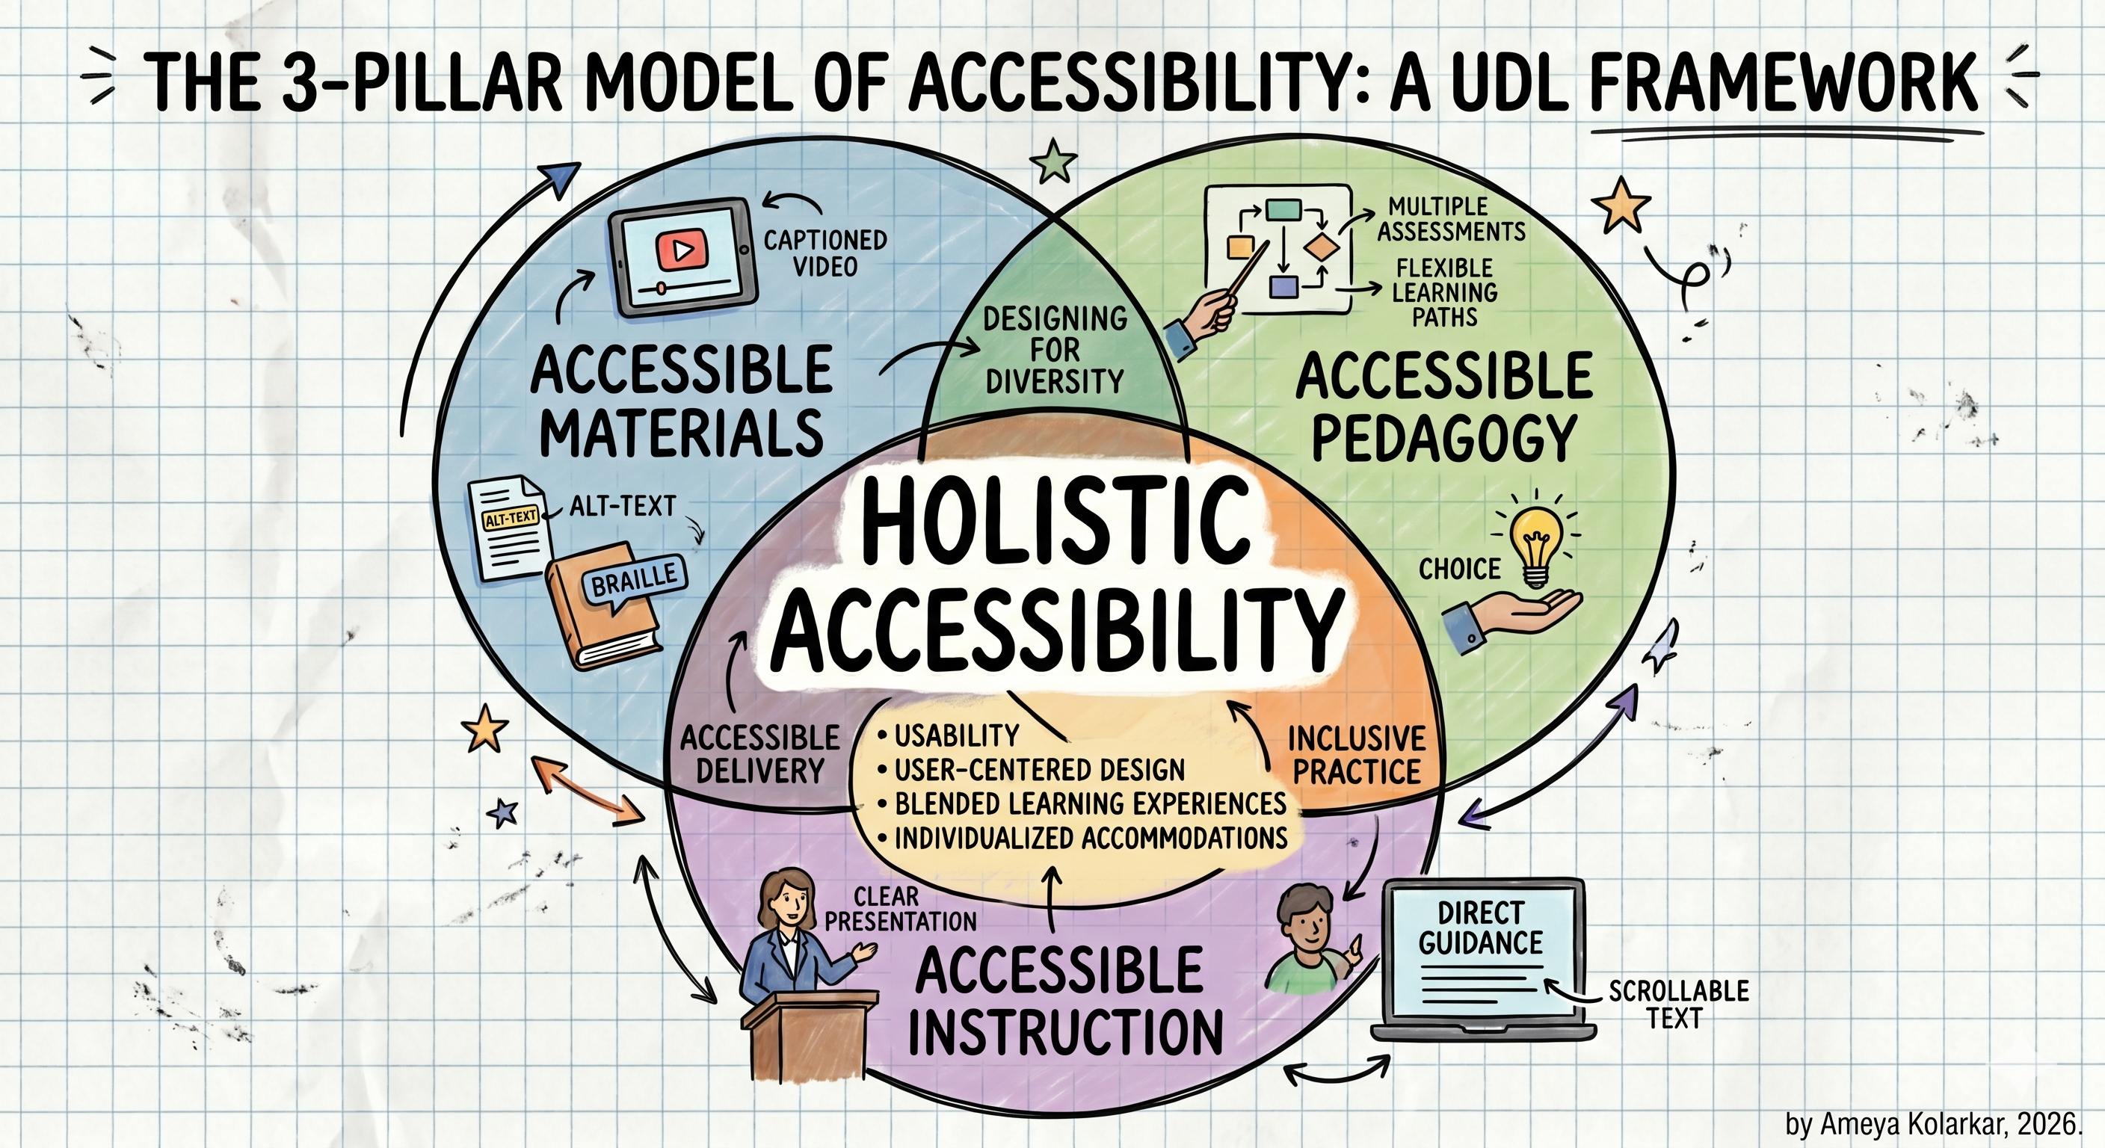
The Three Pilllars of Accessibility
Design
Intentional Pedagogy using UDL and Backward Design.
Materials
Strategic resource generation and delivery.
Instruction
Inclusive real-time practices so all students feel seen.

Slide 10
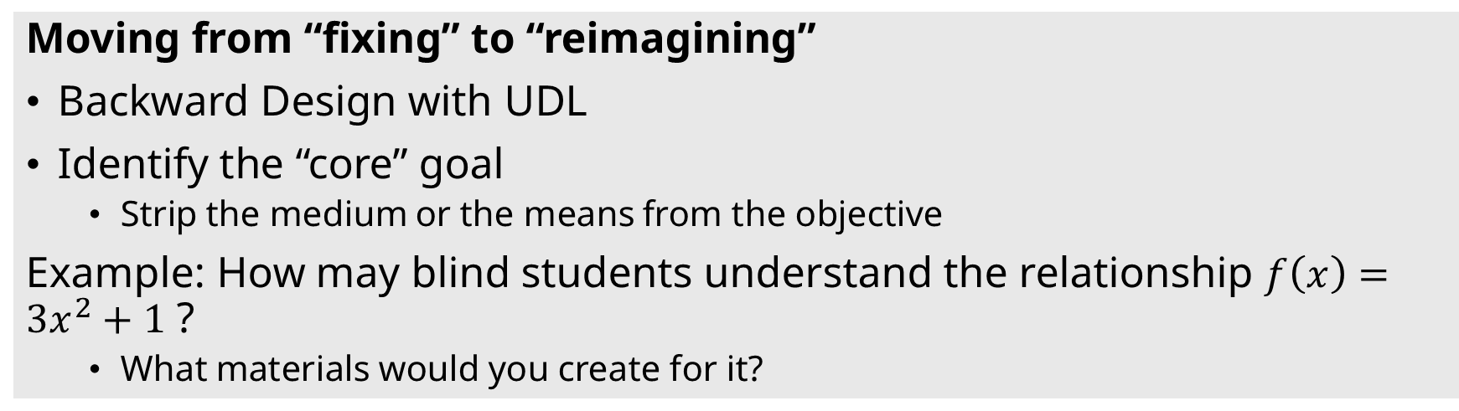
Pillar 1: Intentional Design
Moving from “fixing” to “reimagining”
Backward Design with UDL
Identify the “core” goal
  Strip the medium or the means from the objective
Example: How may blind students understand the relationship $f\left(x\right)=3x^{2}+1$ ?
  What materials would you create for it?
Plan Multi-Modal Learning Evidence
Offer students multiple ways to demonstrate mastery.
  writing/typing, audio/video, drawing, ...
  assignments, quizzes, homework, clickers, in-class work, tests, ...

Slide 11
Activity: The Purpose Pivot (Time-permitting)
Audit: Look at your most difficult course objective.
Consider: Remove mentions or requirements of "read," "see," or "listen.“
  E.g. change “see figure to the right” to “refer to figure number 4”
Rebuild: Focus on the cognitive task (Analyze, Evaluate, Create).
Expand: Identify a few different ways a student could achieve that task.
Or … you could use a human-in-the-loop AI workflow to generate appropriate material artifacts!

Slide 12
Pillar 2: Strategic Materials
Human-in-the-Loop AI
You have the design.
Now let’s create the materials for it.
Ideas?
For prompts and more,
https://math.fsu.edu/~kolarkar/resources/workshop-cotl26.html

Slide 13
Share?
Remember to always check the AI output.
Let’s share some material ideas and/or materials.
  If time is an issue, do little things little by little. Every change matters!*
My Math and Physics projects on PreTeXt – show and tell.
*Make a change; make a difference.

Slide 14
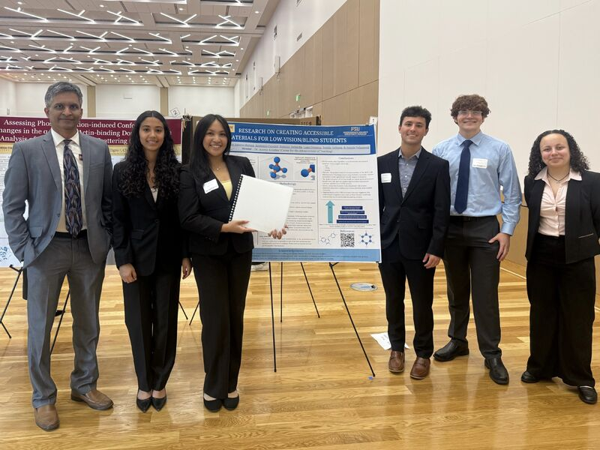
This work is always ongoing!
Thank you!
Questions?
Connect with me at
akolarkar@fsu.edu

